Slide 1

15’min Emergency IBM Capstone
Priyank Patel

Slide 2
CONTENT
INTRODUCTION
GOALS
DATA
METHODOLGY
RESULT
CONCLUSION

Slide 3
INTRODUCTION
The aim of this project is to test the readiness of the city amenities where each residence can reach any necessary amenities like medical services in an emergency within the 15 minutes of timespan.
Here in this experiment, we will be focusing on the Downtown neighborhood of the Washington DC for the medical services available in the reach from downtown.

Slide 4
GOALS
With the help of this experiment, we will try to answer some of the questions like:
What is the overall current state of readiness of the city and the districts within it in respect to this "15 minutes" goal?
Can we identify neighborhoods that share similar characteristics and group them together so that specific dedicated action plans can be defined to enable the "15 minutes" vision in these neighborhoods?

Slide 5
DATA
We will the coordinates of residence to locate the spot and find the medical service in the desirable radius. For this data, we will use the building benchmark data sourced from Open Data DC which contains all the required information.
We will use Foursquare API to search for the medical services using the category ID in reach of every residence.
The new dataframe will be created using both datasets above with the distance between the residence and medical venue, time travel to reach venue, 15minFlag which indicates whether, the distance can be travelled under 15 minutes.

Slide 6
APPROACH
Import the data
Data Preparation
Calculate minimal travel time
Exploratory data analysis
Unsupervised Clustering

Slide 7
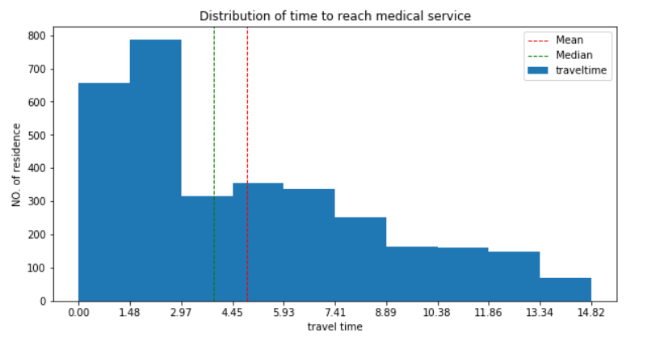
RESULT
The exploratory data analysis shows that every residence present in our downtown dataset in within the range of 15 minutes of travel time by walking to reach to nearest medical service. To travel to the nearest medical service in downtown the average time is under 5 minutes.

Slide 8
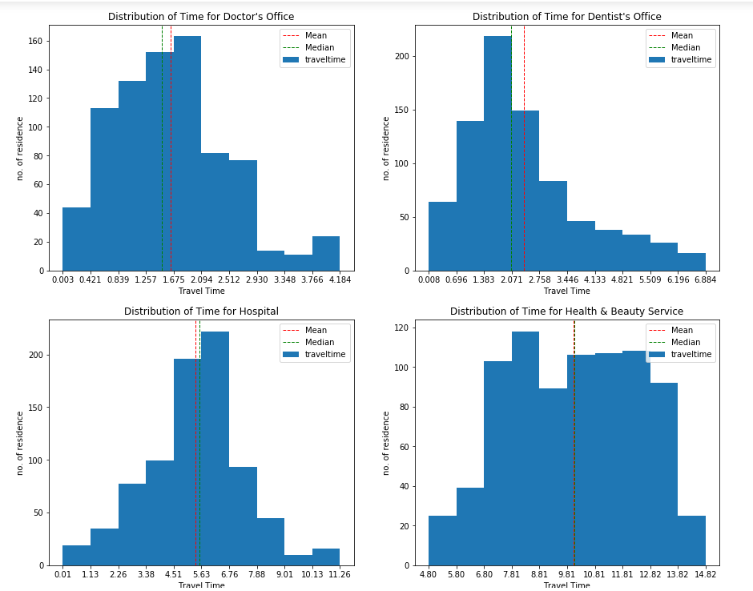
RESULT
To see the distribution of travel time for different medical service such as Doctor’s office, Dentist’s office, Hospital, Health & Beauty Service and the average travel time to reach the nearest venue in each medical service.

Slide 9
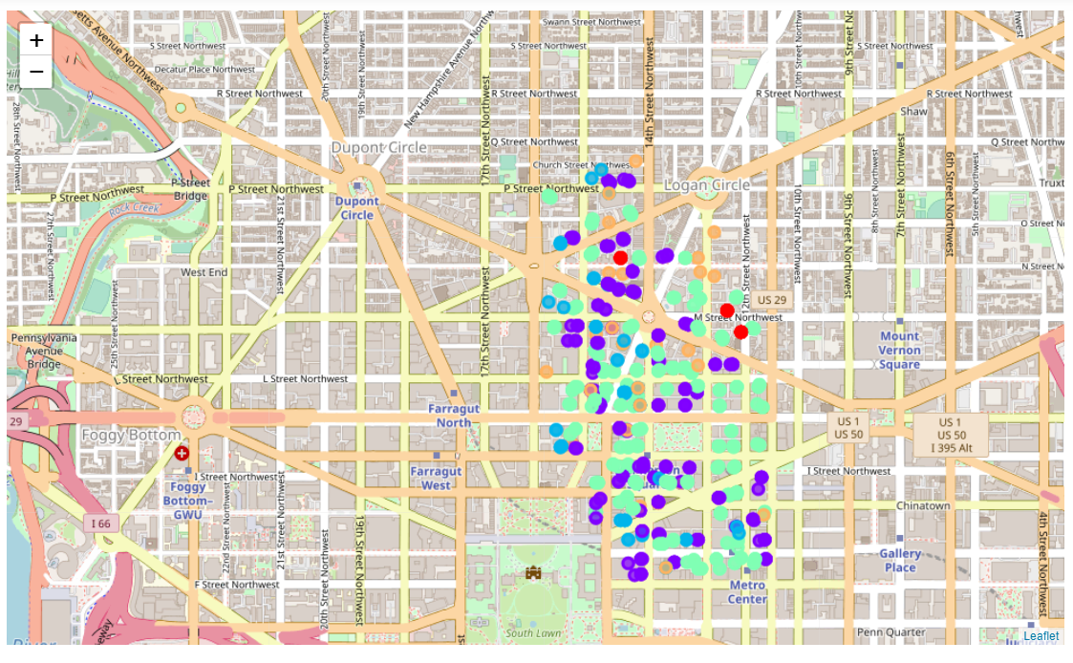
RESULT
Clusters tend to group residences that are in continuous areas, i.e we do not see much dispersion in the way residences within the same cluster are plotted on the map. They tend to form continuous areas that are separate from each other, even if 2 clusters are split into 2 separate areas on the map

Slide 10
CONCLUSION
We also identified common readiness characteristics shared by residences and even neighborhoods within the districts via a clustering exercise, supplemented by a map visualization of the clusters.
We confirmed that every residence in the downtown, is within the reach of every type of medical service/category required within the 15 minutes of walk.

